Slide 1
Why income protection is important
[Presenter’s name]
[Presenter’s title goes here]

Slide 2
Disability insurance from Principal® is issued by Principal Life Insurance Company, 711 High Street, Des Moines, IA 50392.
Please remember to abide by the company’s policy on disclosure of compensation. You can obtain more information, as well as a sample disclosure form, at www.principal.com.
No part of this presentation may be reproduced or used in any form or by any means, electronic or mechanical, including photocopying or recording, or by any information storage and retrieval system, without prior written permission from Principal®.
This is an overview of the benefits of disability insurance, but it has exclusions and limitations. For costs and coverage details, contact your Principal representative.
Not a Deposit | Not FDIC or NCUA Insured | No Bank or Credit Union Guarantee | May Lose Value | Not Insured by any Federal Government Agency
Principal, Principal and symbol design and Principal Financial Group are trademarks and service marks of Principal Financial Services, Inc., a member of the Principal Financial Group.

Slide 3
96.5% of missed work is due to illness, not injury. ¹
¹ Calculated with data from the “Annual Statistical Report on the Social Security Disability Insurance Program, 2017.” U.S. Social Security Administration, Office of Retirement and Disability Policy, Office of Research, Evaluation, and Statistics, October 2018.
3

Slide 4
Help them understand the value of their income
It provides for the big and little things in life.

Slide 5
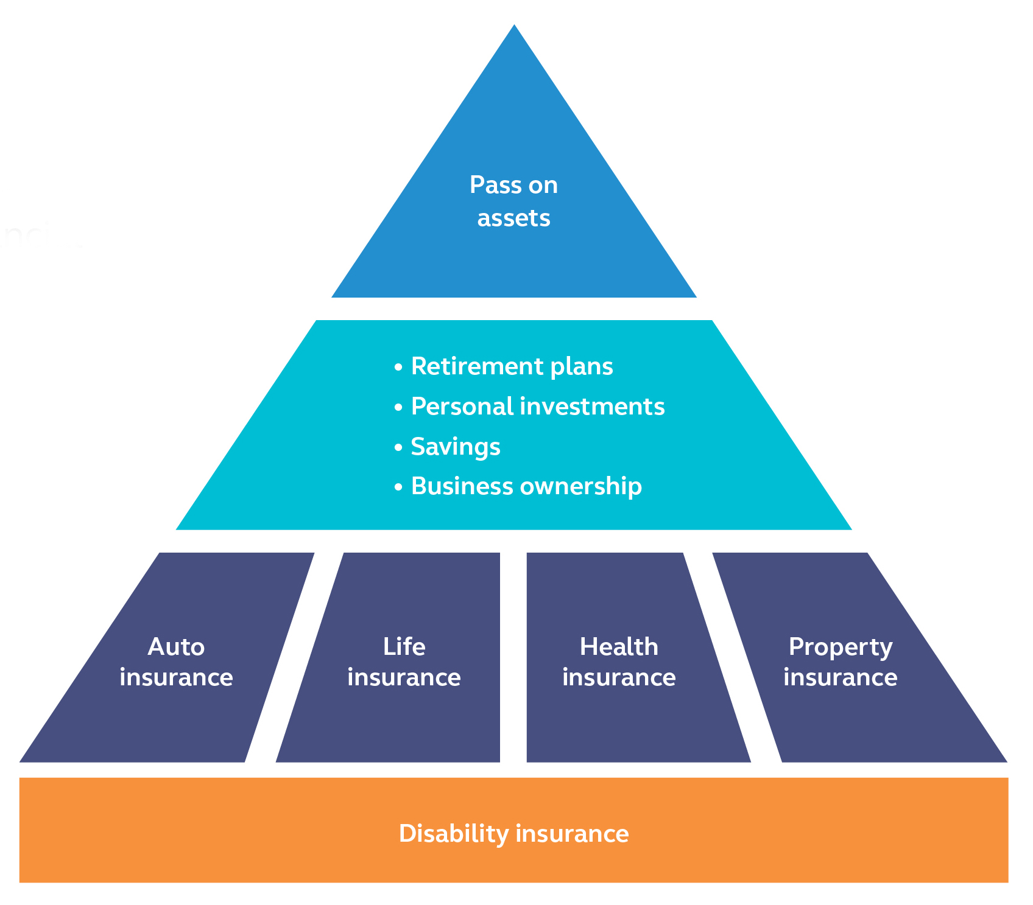
Financial security starts with protecting their income

Slide 6
They need your help getting started

Slide 7
Make it relatable with a checklist
Emergency contact
Child care
Health insurance
Other (pet sitter, lawncare, etc.)
Sick leave
Income protection
Life insurance
Notes:
“Mental checklist”
Ask your client to imagine if they woke up in the hospital tomorrow. Tell them to consider the mental checklist that would run through their mind:
They probably have health insurance to pays the doctors and hospital
And they probably have life insurance in case they die
But what if they survive, and are too sick or hurt to work?
If their checklist doesn’t include disability insurance then you need to talk.
The best case scenario is to have everything on the checklist covered so that they can focus on getting better.

Slide 8
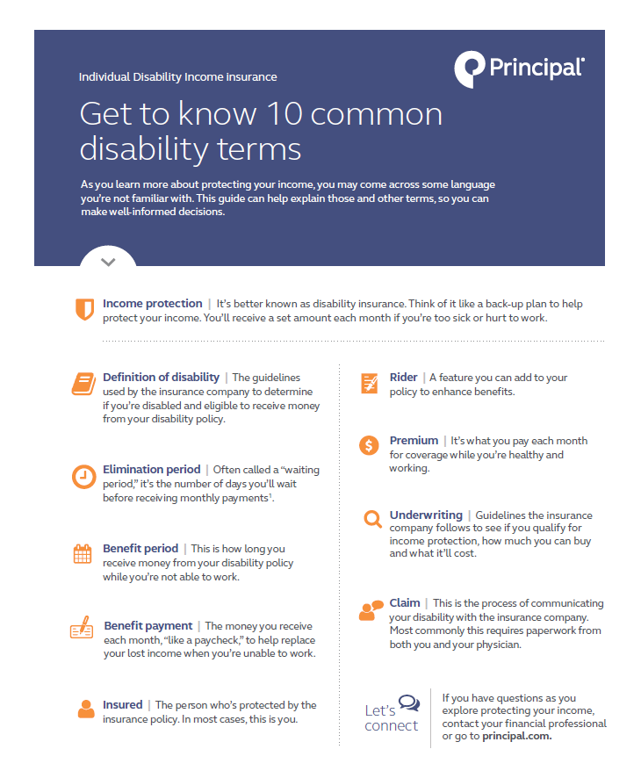
Keep jargon to a minimum
Assure clients the steps they’ve taken are good.
Disability insurance is designed to enhance their protection plans.
Flier (JJ2116) provides an alternative definition for common disability insurance terms.

Slide 9
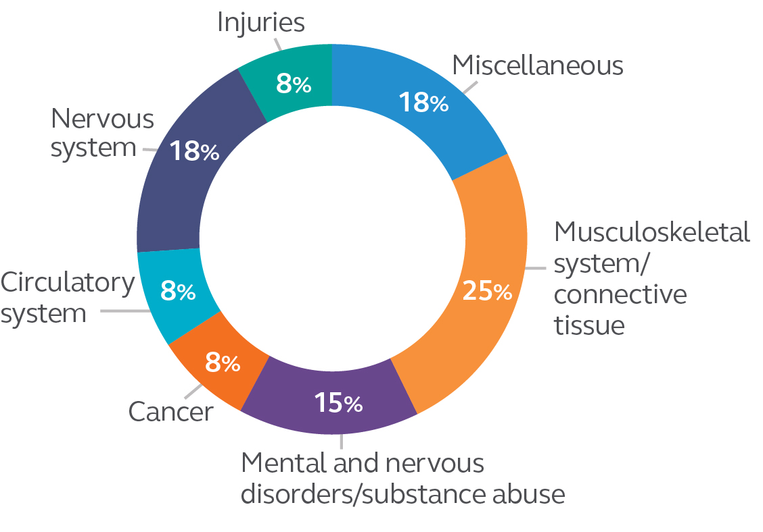
Show them that it’s more than just accidents
Illnesses are the most common causes of disability, and the average disability last 31.2 months.¹
¹ Council for Disability Awareness. Blog.disabilitiescanhappen.org, January 2016. Most recent available.
Chart source: Principal Life Disability insurance active claims as of May 2018. The above is for illustrative purposes only and is not intended as a complete representation of all claims.
For financial professional use only. Not for use with consumers or the public.

Slide 10
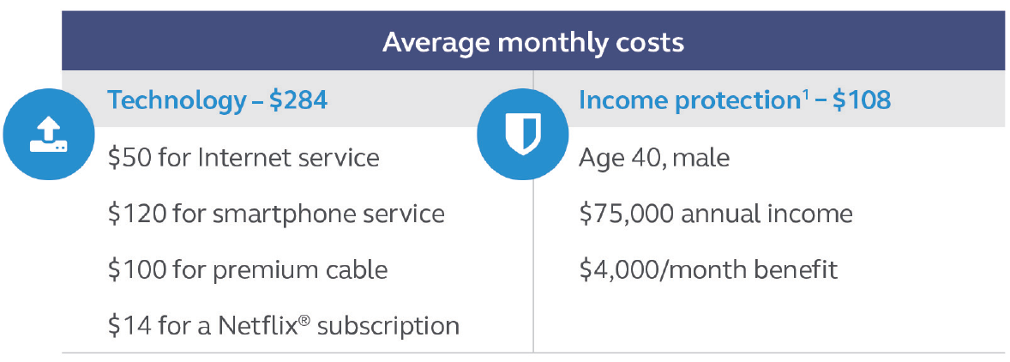
Compare the cost to every day items
Make income protection more tangible by comparing to regular expenses.
Disability insurance typically costs 1-2% of annual income.
Notes:
NON-CALIFORNIA version – if using delete the next slide
Protecting themselves first is all part of a successful financial checklist. Then offer to review their budget to see how to make disability insurance work. It can be more affordable than they may think.
Make it relatable by comparing it to the cost of other common items.

Slide 11
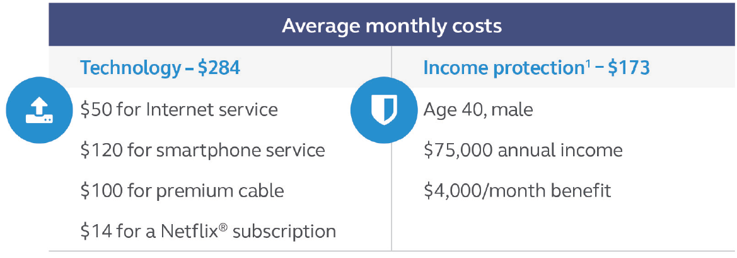
Compare the cost to every day items
Make income protection more tangible by comparing to regular expenses.
Disability insurance typically costs 1-2% of annual income.
Notes:
CALIFORNIA version – if using delete the previous slide.
Protecting themselves first is all part of a successful financial checklist. Then offer to review their budget to see how to make disability insurance work. It can be more affordable than they may think.
Make it relatable by comparing it to the cost of other common items.

Slide 12
Ready to get started?

Slide 13
Put yourself first
When you buy coverage for yourself, you’ll:
Have your most valuable accomplishment protected.
See the new business and underwriting process first hand, so you can better explain it to your clients.
Plus, once you have one sale, you have access to IDI eApp and ePolicy from Principal.

Slide 14
The market opportunity is huge
Almost everyone in the working population needs to protect their income. That makes many people good candidates for disability insurance, especially those who:
Are age 30 to 55.
Earn $40,000+ a year.
Work 20+ hours per week.
Work for professional service-related companies.

Slide 15
Talk about the benefits of coverage
Flexible solutions to fit different needs and budgets.
Works well with other disability income solutions.
Can’t be canceled or changed unless the client takes an action.
Stays with the client even if they change jobs.
Plus, discount opportunities may be available.

Slide 16
If your client becomes too sick or hurt to work
Contact Principal and tells us what happened.
We’ll keep the client up to date on the status of their claim.
They’ll receive a fair claim decision within 7 business days.
$94.8 million
in claims was paid in 2018 — helping to provide the financial support needed.¹

Slide 17
Next steps
Offer an income protection review to all of your clients.

Slide 18
Information needed for a personalized proposal
Name
Gender
Date of birth
Occupation and job duties
Salary
State of residence
Tobacco use
Known medical issues
Desired amount of income replacement benefit
Any known existing disability coverage

Slide 19
Thank you
DI9584-06 │ 04/2020 | © 2016-2020 Principal Financial Services, Inc.

